Slide 1
CS3200 Project - MusicDB
Nam nhat luu
JAEJIN Lee
Duy vu

Slide 2
Background Info
Listeners of different music platform
Local drive music library/database
In order to find one song, need to search on each online service
Even then, your library info are separated into multiple accounts

Slide 3
Features
An IMDB for music
Web GUI interface
Create account, login, manage account
Search for song on multiple music sources
Add song to one single library
Ability to create playlist of songs
Comment/rate on songs in the library for others users to see

Slide 4
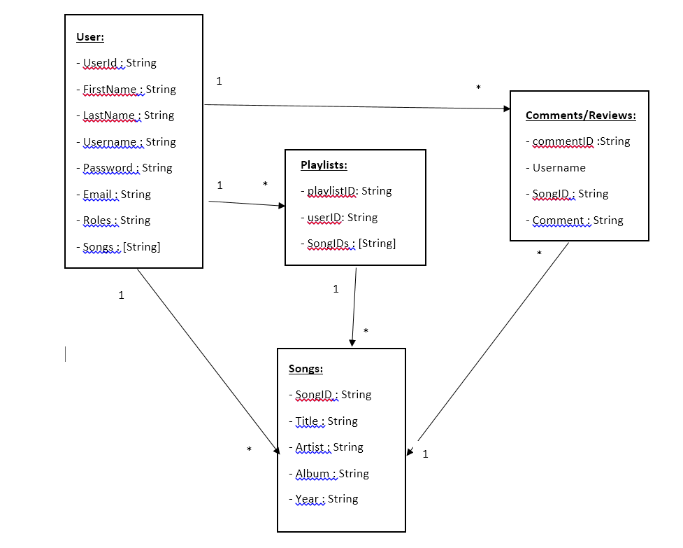
Database diagram

Slide 5
Technical aspects
MEAN Stack
Front end: AngularJS, HTML, CSS, Jquery
Back end: NodeJS
Database: MongoDB
Spotify API for demo catalog
(other sources can be integrated easily form the back end)
Hosted on OpenShift

Slide 6
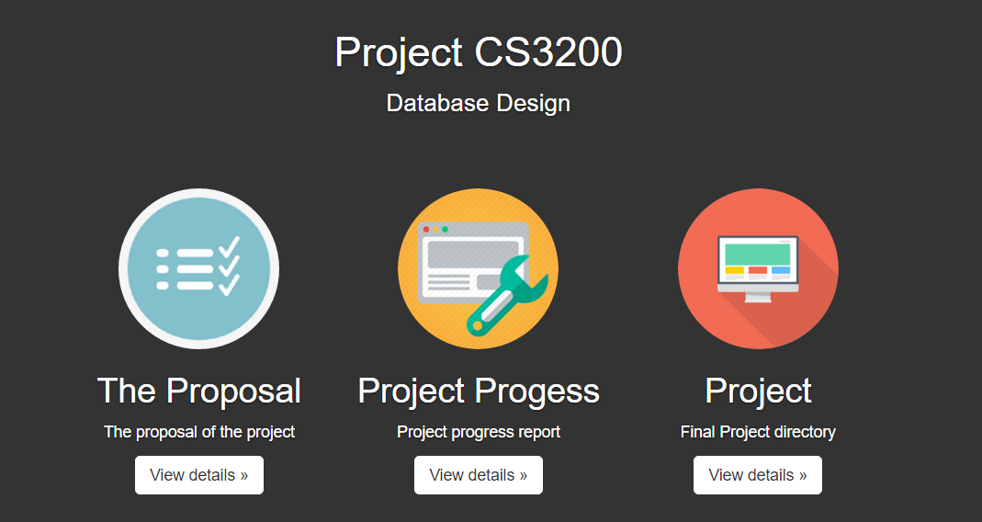
Demo!
http://cs3200project-myneu.rhcloud.com/public/index.html

